Slide 1


Save all the datas!
The journey to a RISE relational Database

Slide 2
A brief introduction to RISE
And our interactions

Slide 3
What does RISE do?
If you're in a STEM major they will hook you up
Job applications, internships, etc.
They'll set you up with a teacher/mentor to do research projects
Connect instructors with community projects for their classes (service learning)
Bring in organizations for job fairs and other events
Put on STEM oriented workshops
Ex. Light a pumpkin with an arduino (Fall '17)
Ex. Learn to solder (Fall '17)

Slide 4

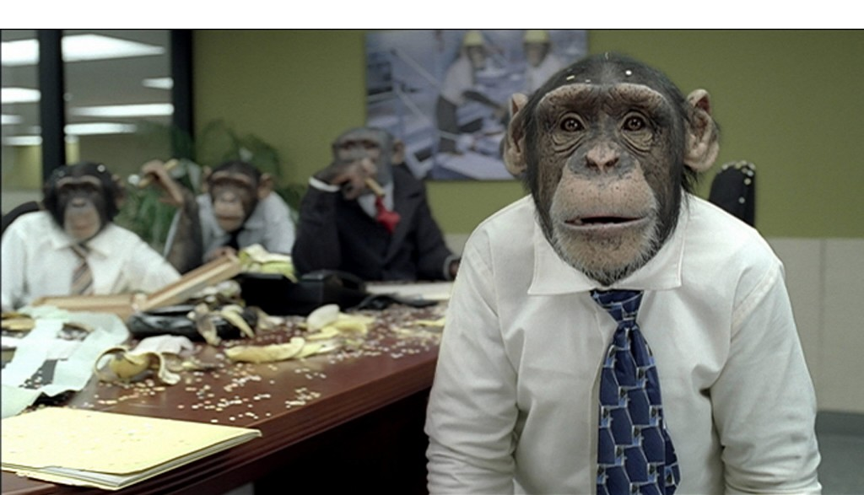
First meeting
Three people:
Michael Reese (director)
Sapan - administration focused
Chiew – advising focused
1.5 hours
They kind of knew what they wanted
Jumped around topics
Easily side-tracked

Slide 5
Second meeting
We had sent them a list of things to think about
Chiew was in China for three weeks
Unfortunate because we decided to limit our scope to student oriented portions
Were able to nail down a solid ERD foundation
Received forms that gave us most attributes that would be the DB

Slide 6
Third meeting
Making sure our database covered their biggest needs
Cut student projects as they aren't doing too many yet and it's fairly complex to implement
Explained the ERD
Michael expressed he'd be interested in expanding the database at some point
If anyone is interested, maybe hit him up for an internship
Or the next databases class could add to it
Very happy with what we've got

Slide 7
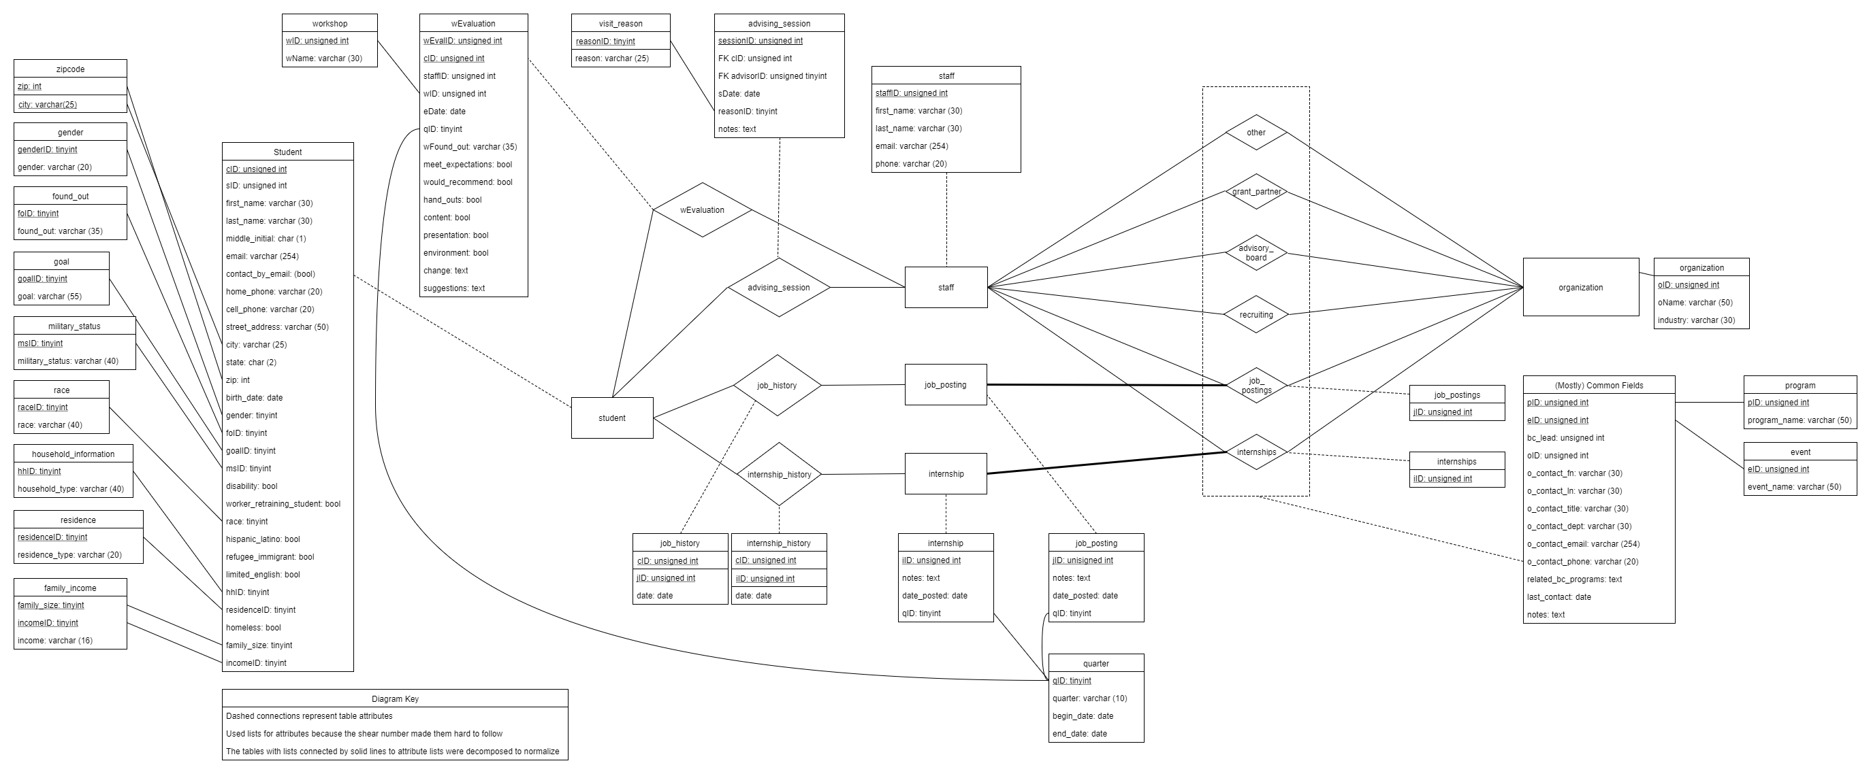
Database architecture
Or how we bent the ERD to our bidding

Slide 8

Client requirements
Two Main Things
Keep track of student advising
Includes non-student community members
Keep track of organization relationships
Many organization types
Many relationship types

Slide 9
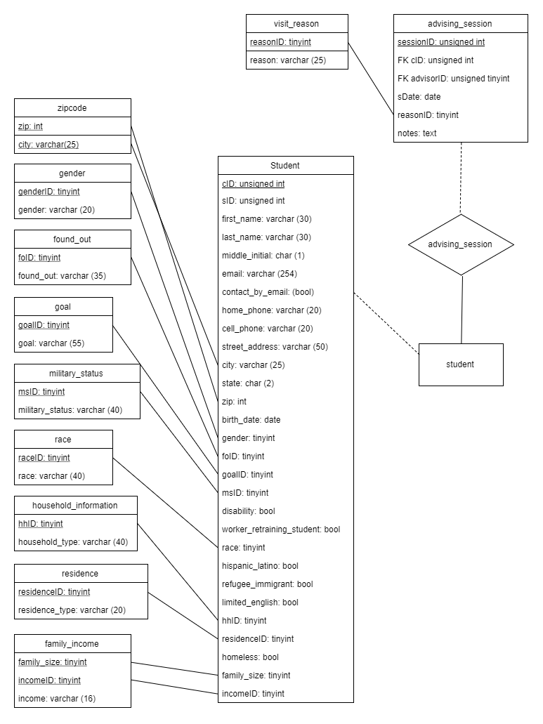
CLIENT REQUIREMENTS: STUDENT ADVISING
Top priority is keeping track of demographic data
Must be able to generate reports by zip code with demographic filters
Keep track of advising sessions
Limit of three for non-students
A student may meet with different advisors

Slide 10
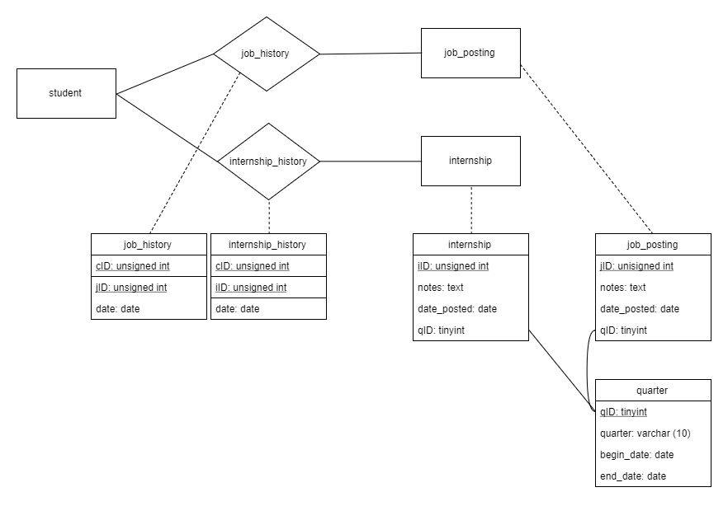
Client requirements: student advising
Advisors want to see job/internship history and any past notes
Time stamp job/internship applications
Track successful applications
Be able to retroactively add job/internship history

Slide 11
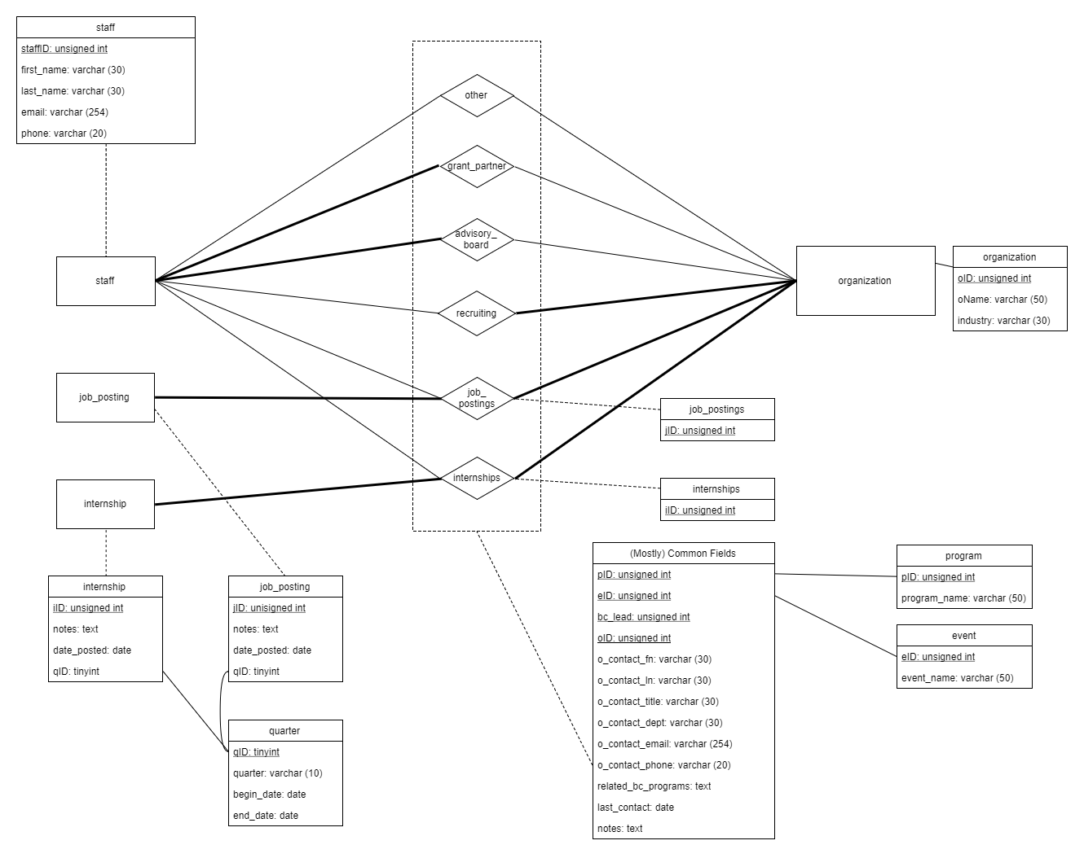
CLIENT REQUIREMENTS: ORG RELATIONSHIPS
Each relationship with an organization may have a different contact
Relationships may have a RISE lead who maintains the relationship
Wants to be able to report number of relationships of which types with all organizations
Relationship Types:
Grant Partners
Advisory Board
Recruiting
Job Posting
Internship Posting
Other – the catch all
Organization Types:
Companies
Non-profits
Government Agencies
Academic Institutions

Slide 12
Insert demo here
Don't forget to insert some totally unfunny transition image (Mike)

Slide 13
Project management
Egg surgery and making salt from spilt milk tears

Slide 14
Unknown beginning challenges
Getting everyone into the same room was a task
Two seniors not free before class
One with an internship, generally working in the afternoon
Another who has to get home to take care of two infants
Clients are busy
Only kind of knew what we were doing, wasted time on vagaries
Scope hard to judge before knowing what we know now
Notes:
Lucky our client posts his schedule
Not one client meeting included all four of us
The day we covered using Java to interface was my oh crap moment

Slide 15
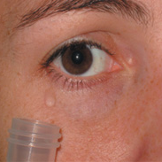
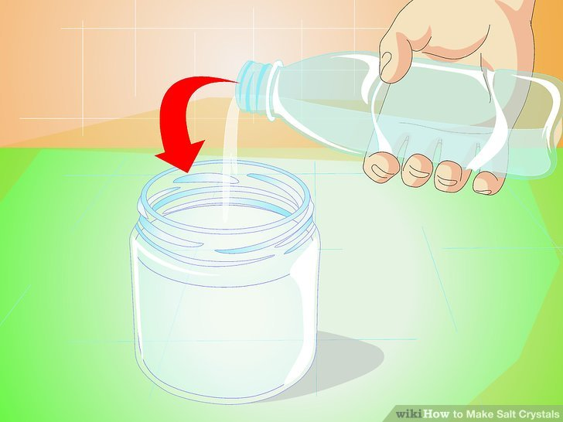
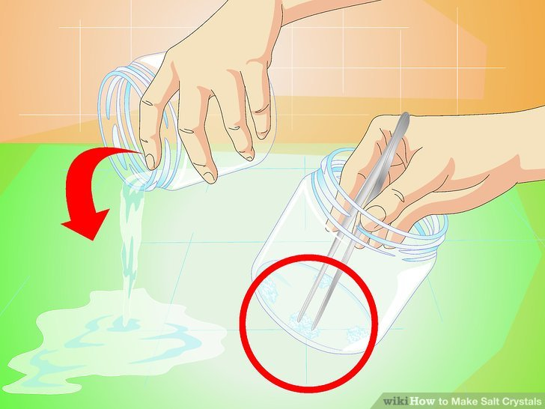
Making salt (Successes)
Best thing we did was get on Github
We could work asynchronously
Kept us organized, could divvy up work
Conference calling ftw because Skype is borked and you can't physically meet with someone in Oregon
Sent client a list of things to think about before meetings
They provided forms they currently use so we didn't have to cover attributes at the meeting

Slide 16
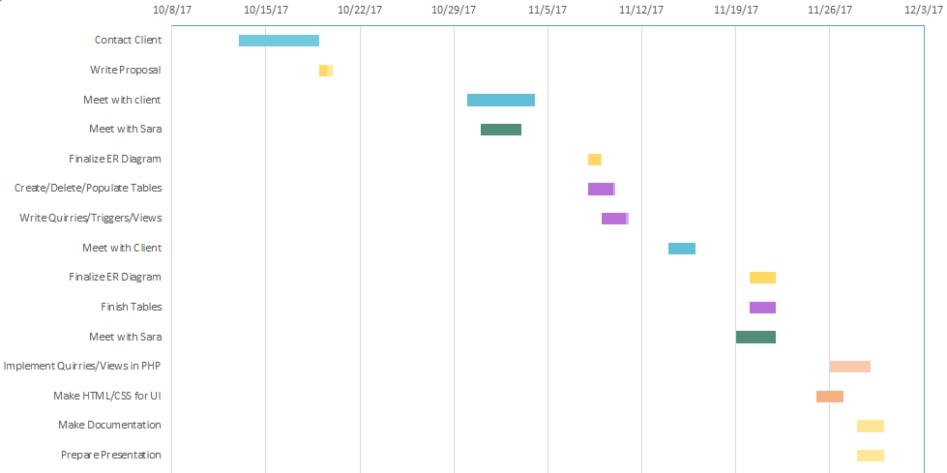
The timeline highlights
Week 1 + 2
Fumbling for a client and setting up a first meeting
Week 3
Maybe we'll get feedback to help with the next client meeting?
Week 4
Schedule with client, oh wait feedback
Week 5
Can't physically meet together, start using Github and rush to finish milestone 2
Week 6
Client is ecstatic with design we've presented to him
Week 7 + 8
Erik requests we present first at meeting with Sara
UI critical team member goes into food coma during crunch time
Where ma peeps?

Slide 17
Egg surgery (what we could do better)
Keep in better contact
If there is a problem or blocker don't keep it to yourself
Find a way to spread working time
Better utilize physical meetings
Draw up unambiguous specs
Have a plan going into client meetings
Notes:
In a professional setting with a good project leader, blame isn't a thing. The only thing that matters is solving the problem and moving on.
It's stressful working at the last minute, but may be unavoidable
Done is better than perfect
For those who can't make it to client meetings or physical meetings and tend to be assigned tasks, having detailed specifications will save time and frustration
Client meetings tended to jump around between what's part of the database, hopes and dreams, how things are connected and so on

Slide 18
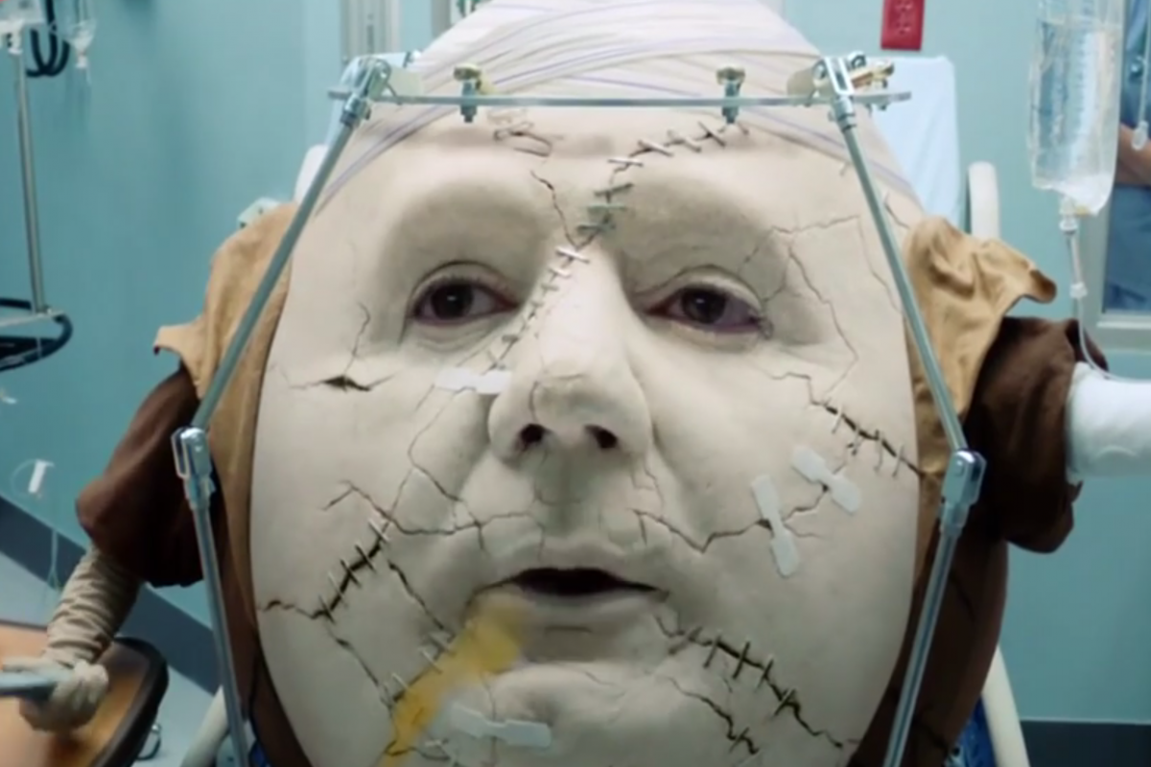
Egg Surgery (Suggestions)
If a client absolutely needs a UI, maybe don't pick them unless your team isn't already doing every other activity in the world
A list of pre-screened potential clients to choose from
Would shrink milestone 1 to a week
Circumvents student naivety
Maybe an intermediate milestone between 1 and 2
Work is currently loaded toward the end of the semester
Devote a bit of class time to doing projects
Allows groups with tight schedules to have time together
Teacher can wander around a get an idea of how groups are doing

Slide 19
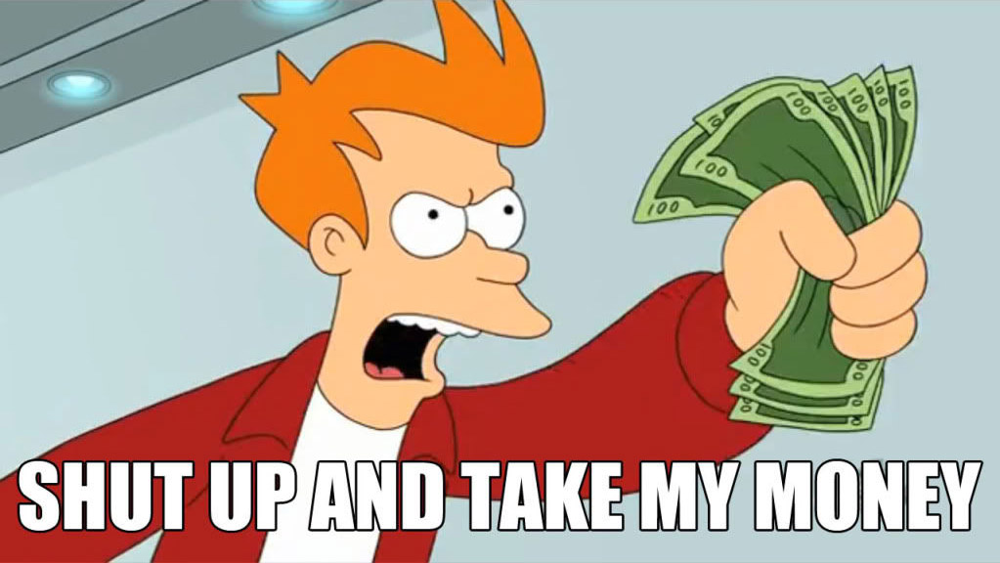
Notes:
Said the client

Slide 20
Questions?
Shout out to draw.io
For having a great
Diagramming tool

